Slide 1
CS217 – Object Oriented Programming (OOP)
Week – 14
May 09 - 13, 2022
Instructor: Basit Ali

Slide 2
Errors!
In software industrial programming most of the programs contain bugs. Bigger the program greater number of bugs it contains.
The following are mainly errors or bugs that occurred in any program:
Logical error: In this error the logic implemented is incorrect. This error occurs due to less concentration of programmer or poor knowledge of programmer regarding program.
Compilation error: This error is occurred due to use of wrong idiom, function or structure. This error is shown at compilation time of program.
Run Time error: This error occurred at the run time. This error occurs when program crashes during run time..

Slide 3
Exceptions!
An exception is a situation, which occurred by the runtime error. In other words, an exception is a runtime error.
Exceptions are different, however. You can't eliminate exceptional circumstances; you can only prepare for them. Your users will run out of memory from time to time, and the only question is what you will do. Your choices are limited to these:
Crash the program.
Inform the user and exit gracefully.
Inform the user and allow the user to try to recover and continue.
Take corrective action and continue without disturbing the user.

Slide 4
Exception handling in Java
statement
statement
statement
exception ……an exception occurred, then JVM will handle it and will exit the prog.
statement
statement
statement

Slide 5
Exception handling in Java (cont..)
For handling exceptions, there are 2 possible approaches
1. JVM
If an exception is not handled explicitly, then JVM takes the responsibility of handling the exception.
Once the exception is handled, JVM will halt the program and no more execution of code will take place

Slide 6
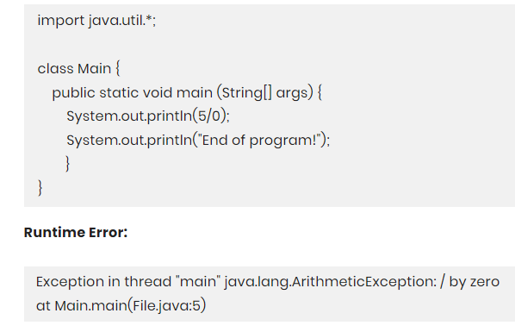
Exception handling in Java (cont..)
1. JVM - Example:

Slide 7
Exception handling in Java (cont..)
2. Developer
Developers can explicitly write the implementation for handling the exception. Once an exception is handled, the normal execution of code will continue.
Preferable: handle exceptions to ensure your code gets executed normally.

Slide 8
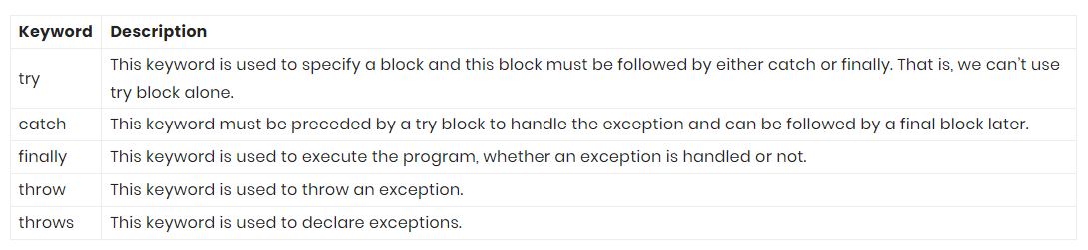
Java Exception Keywords

Slide 9
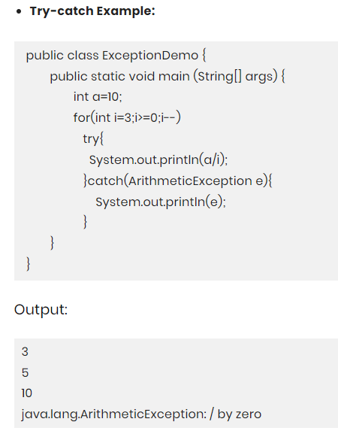
Java Try-Catch Block
Try-catch syntax:
try{
}
catch(Exception e){
}

Slide 10
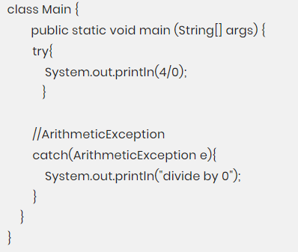
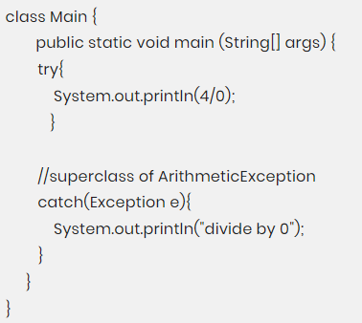
Objects in Catch Block
1. Exact Exception 2. Superclass of Exact Exception

Slide 11
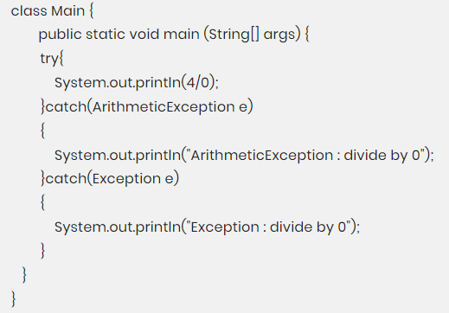
Java Multiple Catch Block

Slide 12
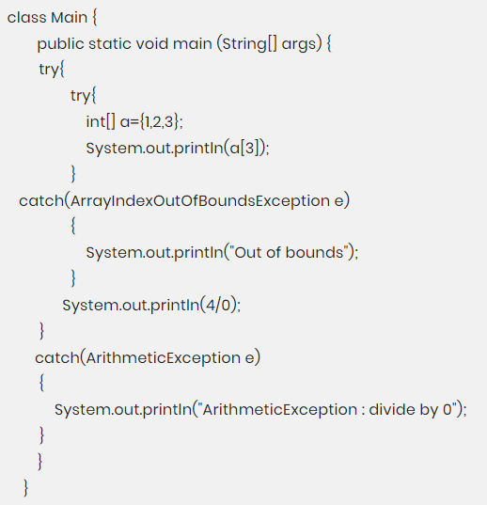
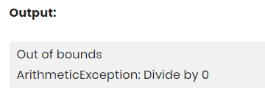
Java Nested Try

Slide 13
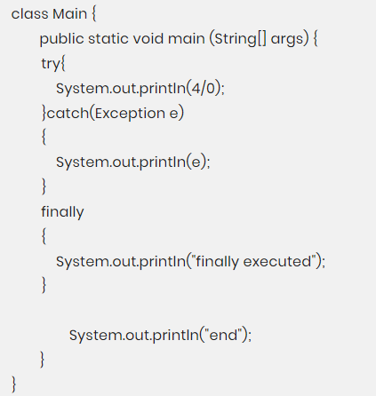
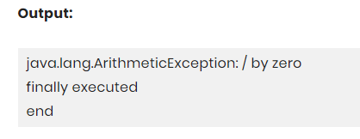
Java Finally Block
Contains code that must be executed no matter if an exception is thrown or not. It contains code of file release, closing connections, etc.

Slide 14
Java Throw Keyword
It is a keyword that is used to explicitly throw an exception.
We can use throw where according to our logic an exception should occur.

Slide 15
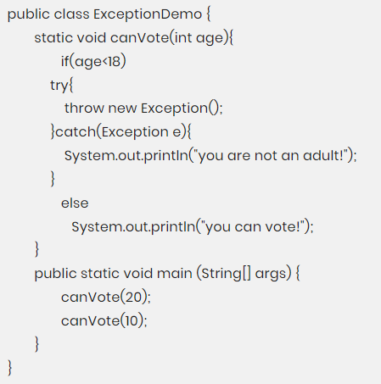
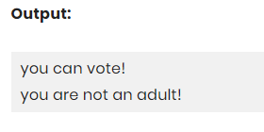
Example

Slide 16
Java Custom Exception
You can create your own exception and give implementation as to how it should behave. Your exception will behave like a child’s class of Exception.
class YourException extends Exception{}

Slide 17
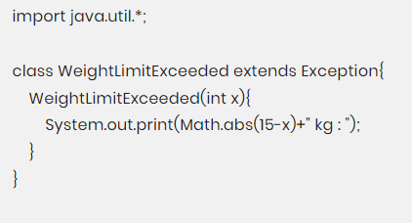
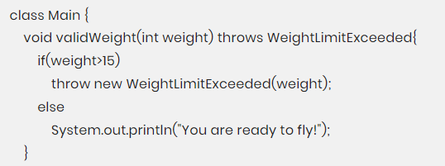
Example

Slide 18
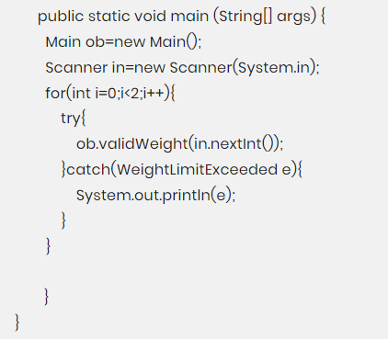
Example(Cont..)

